Slide 1
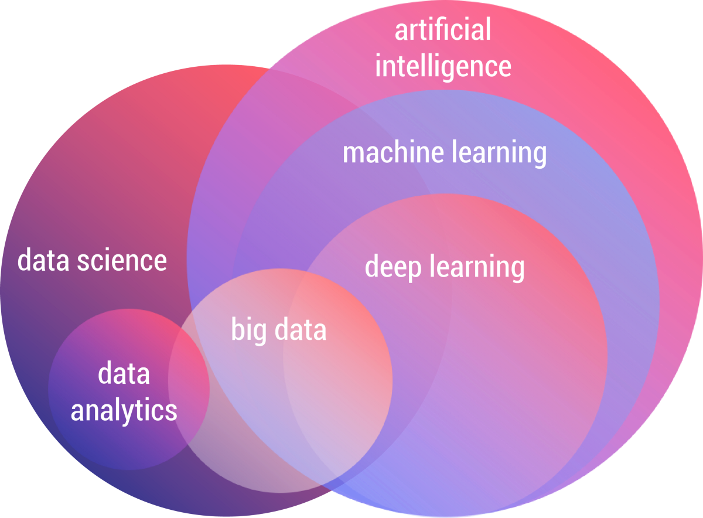

Slide 2
ML
Machine learning
Machine learning uses artificial intelligence to enable machines to learn and predict outcomes more accurately without being explicitly programmed to do so. This makes them more similar to humans. The machine learning models continuously learns and improves its performance with the use of necessary data.

Slide 3
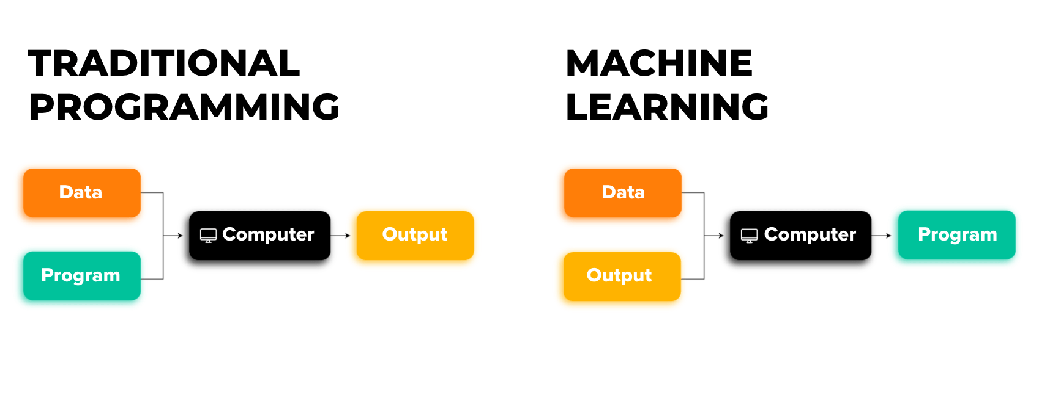
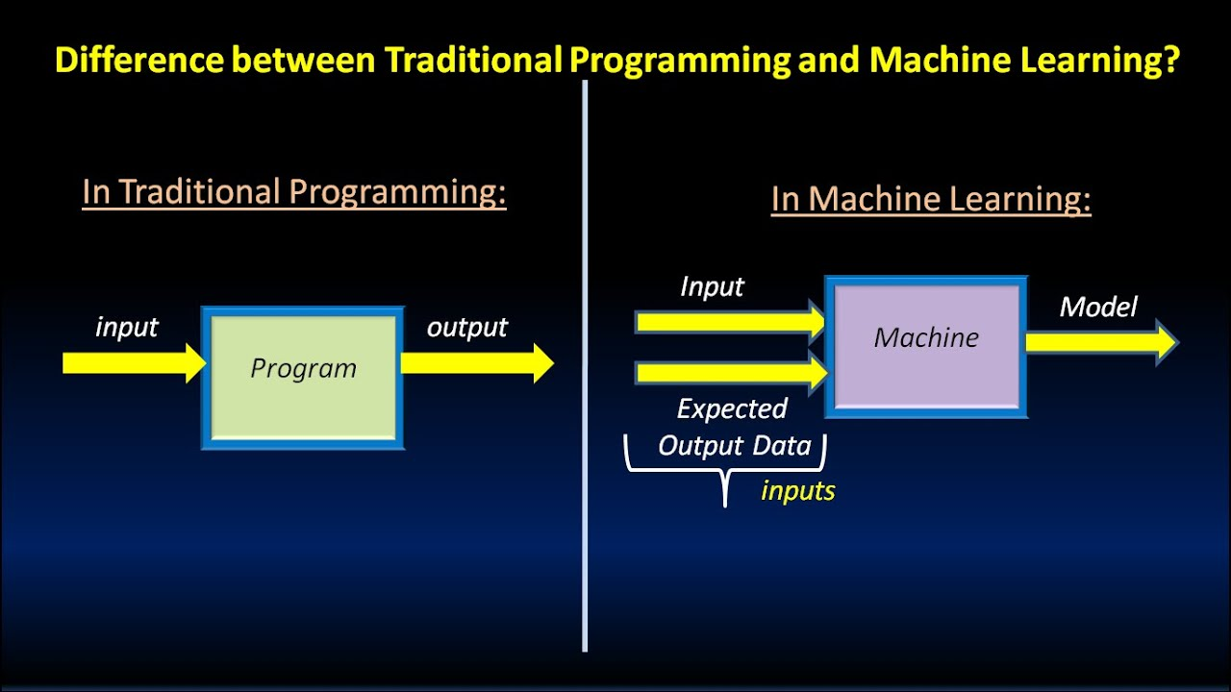

Slide 4
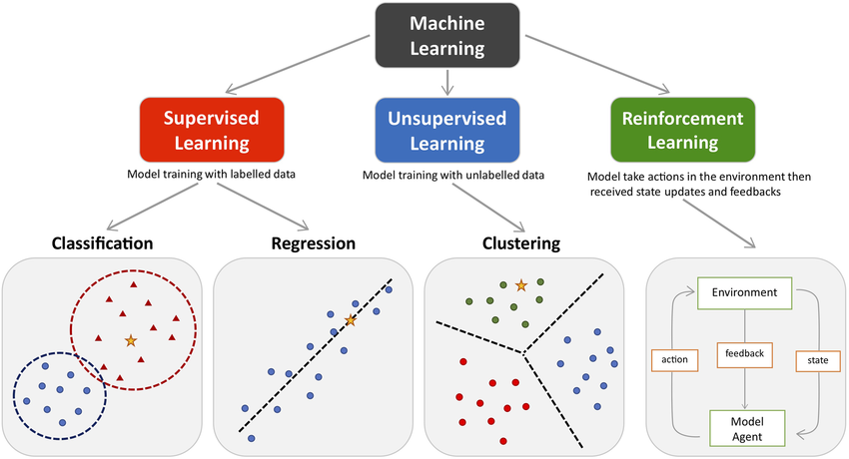

Slide 5
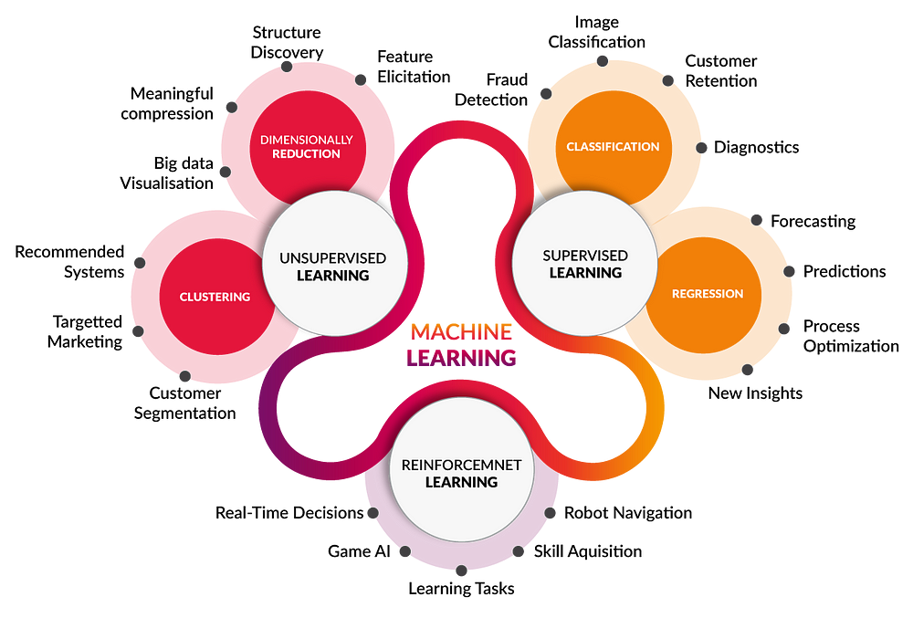
Examples use case

Slide 6
Data
ML Algorithm
ML Model

Slide 7
Steps in ML
1. Data collection
2. Data preparation
3. Choose a ML model
4. Train the model
5. Evaluate the model
7. Make predictions
6. Parameter tuning

Slide 8
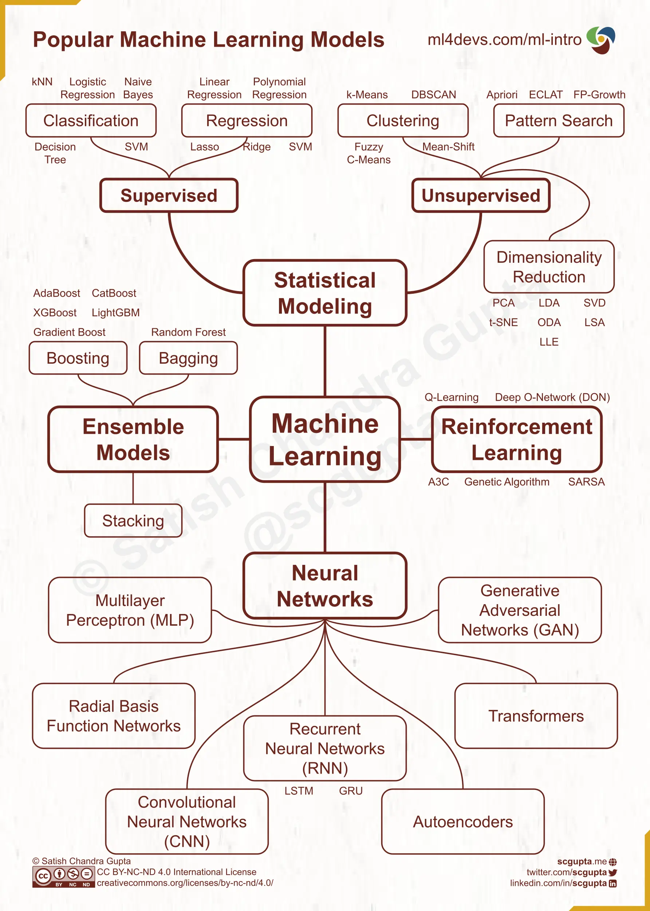
https://pythonnumericalmethods.studentorg.berkeley.edu/notebooks/chapter25.01-Concept-of-Machine-Learning.html

Slide 9
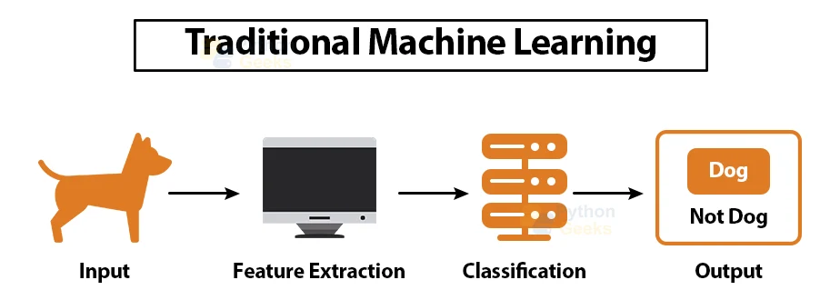
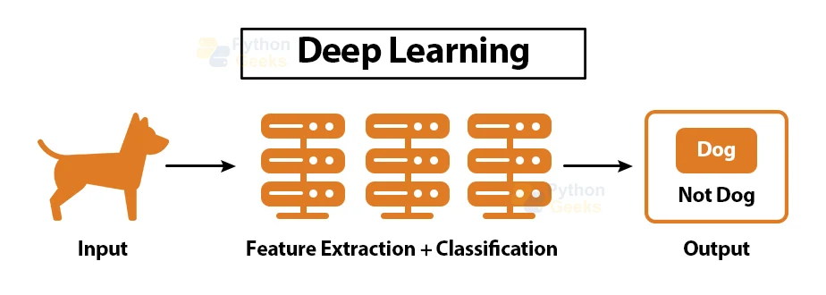

Slide 10
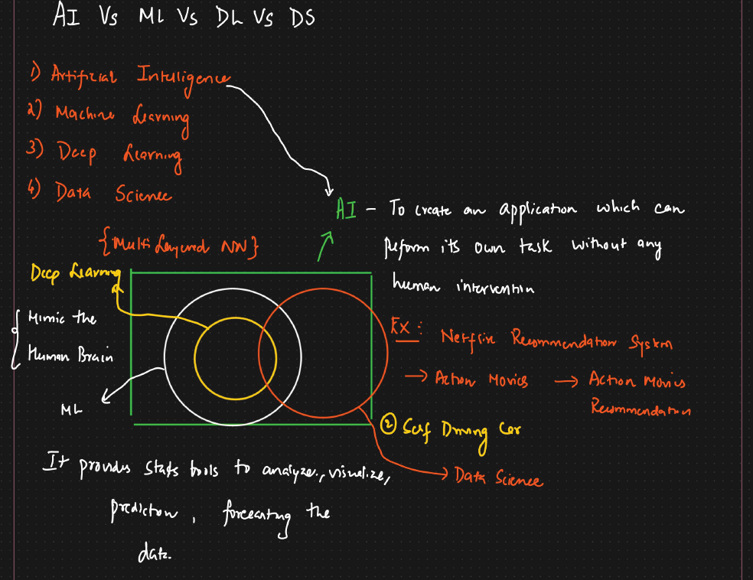

Slide 11
Definations of Deep learning
AI vs DL vs ML
usecase
AI is a broader term that describes the capability of the machine to learn and solve problems just like humans. In other words, AI refers to the replication of humans, how it thinks, works and functions.
There are two ways of incorporating intelligence in artificial things i.e., to achieve artificial intelligence. One is through machine learning and another is through deep learning. That means DL and ML are ways of achieving AI.
ML comprises algorithms for accomplishing different types of tasks such as classification, regression, or clustering. The accuracy of algorithms increases with an increase in data.
“Difference between the predicted and actual value is computed using loss-function or objective function. Therefore, defining the objective/loss function is the gist of ML model.”
This is one of the reasons for the misconception that ML and DL are the same. However, the DL model is based on artificial neural networks which have the capability of solving tasks which ML is unable to solve.

Slide 12
Advantages of DL over ML
1. Feature Extraction
Machine learning algorithms such as Naive Bayes, Logistic Regression, SVM, etc., are termed as “flat algorithms”. By flat, we mean, these algorithms require pre-processing phase (known as Feature Extraction which is quite complicated and computationally expensive) before been applied to data such as images, text, CSV. For instance, if we want to determine whether a particular image is of a cat or dog using the ML model. We have to manually extract features from the image such as size, color, shape, etc., and then give these features to the ML model to identify whether the image is of a dog or cat.
However, DL models do not any feature extraction pre-processing step and are capable of classifying data into different classes and categories themselves. That is, in the case of identification of cat or dog in the image, we do not need to extract features from the image and give it to the DL model. But, the image can be given as the direct input to the DL model whose job is then to classify it without human intervention.
Raw Data is given to DL model. Pre-processed data is given to ML model.

Slide 13
2. Big Data
With technology and the ever-increasing use of the web, it is estimated that every second 1.7MB of data is generated by every person on the planet Earth. Therefore, analyzing and learning from data is of utmost importance.
Deep Learning is seen as a rocket whose fuel is data.
The accuracy of ML models stops increasing with an increasing amount of data after a point while the accuracy of the DL model keeps on increasing with increasing data.
https://shahilansari.medium.com/machine-learning-vs-deep-learning-vs-artificial-intelligence-ml-vs-dl-vs-ai-3f95dfa7ef87

Slide 14
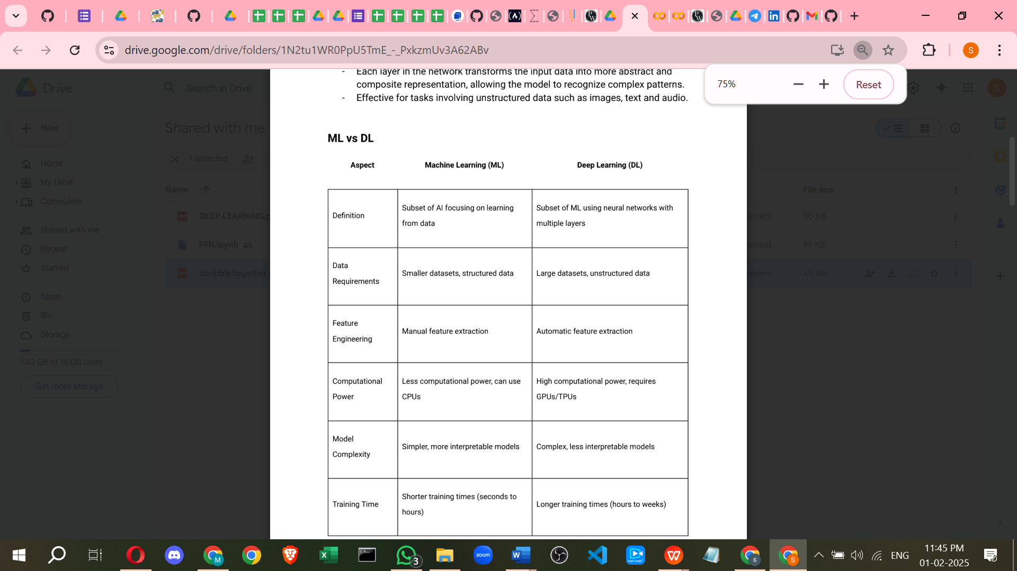

Slide 15
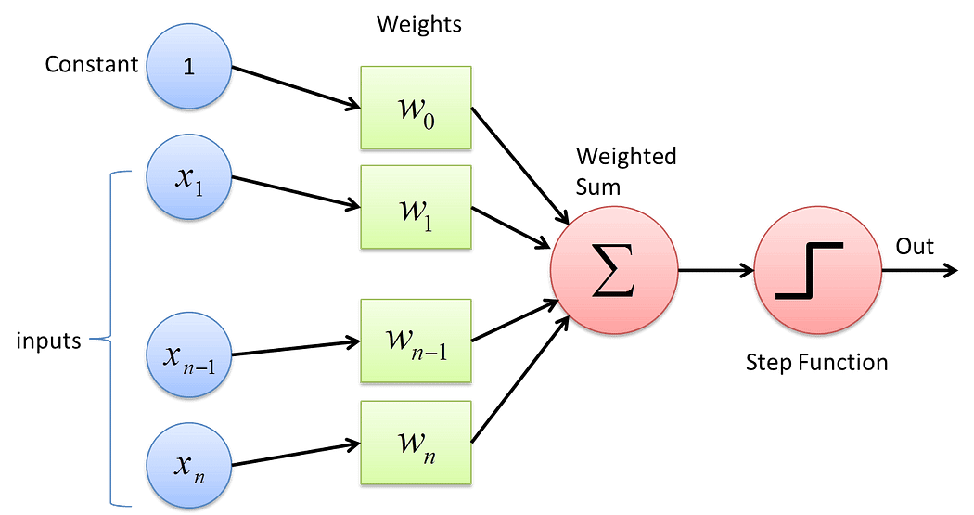
what is ai ml, dl
and where data analyst and data scientist stand
what is deep learning
Artificial neural network
why deep learning is so popular?
IN dl pass all types of data(image, video,audio,text)
NO feature engineering needed(automatic feacture extraction
scale of data DL accuracy improve but in ML not
DL is use in many domain
how DL works?
help of neural network.(what is NN) BIOLOGICAL NEURON:
https://drive.google.com/drive/folders/1N2tu1WR0PpU5TmE_-_PxkzmUv3A62ABv
basic unit of NN is Perceptron.(what is Perceptron) Simples ANN Architecture.
Framework --> keras, tensorflow, pytorch, mxnet etc
Preceptron Consists of :
i) 1 input layer
ii) 1 output layer (output node)
iii) No hidden layers
iv) Weights
v) Bias
vi) Summation Function
vii) Activation Function
https://medium.com/towards-data-science/what-the-hell-is-perceptron-626217814f53

